Slide 1

SOCIAL NETWORKING WEBSITE ( Professional Networking and Job Search Platform )

Slide 2
Tech Buddies
IBM Mentor
Mrs. Swathi K.
Edunet Mentor
Mr. Ankur Mishra
Student’s Name
Keerti Vishwkarma
Sushmitha P.
Ajay Kumar

Slide 3
Workload Division
Contribution of each team member in project :
Keerti Vishwkarma :- Frontend / Backend Development / Database / Deployment​
Ajay Kumar :- Frontend Development / Database​
Sushmitha P. :- Resources​ / Documentation​

Slide 4
The Background
Historic Background
The job market is increasingly shifting towards online platforms where professionals can connect, share expertise, and apply for jobs.
Current job search websites like LinkedIn and Indeed are powerful but come with challenges like limited networking within specific industries.
Current Scenario
Fragmented platforms where job seekers and employers struggle to find tailored connections.
Need for a simplified, professional networking platform that enhances the job search and application process.

Slide 5
Problem Statement
Problem
Many platforms are either too general or too specialized, making it hard for users to form valuable professional connections.
Users need a better way to showcase their skills, build professional connections, and find relevant job postings.
Starting Stage
Identified the need for a platform that focuses on industry-relevant networking.
End Goal
Build a professional network where users can connect, share job opportunities, and advance their careers in a focused manner.
End Users
Job seekers, employers, industry professionals.
Domain
Professional networking and job search.

Slide 6
Proposed Solution
Solution Overview
JobHive :- A professional networking platform that combines social networking features (like connections, posts, and messaging) with a job board.
A one-stop platform where professionals can expand their network and apply for jobs that align with their skills.
Key Features
User profiles with skills, experiences, and connections.
Job posting and search functionality.
Messaging system for direct communication between users.

Slide 7
Solution Design
UML Diagrams
User interactions (profile creation, job posting, messaging).
Data flow between frontend, backend, and database.
Architecture
Client-side: Browser (HTML, CSS, JavaScript).
Server-side: Java (Spring Boot APIs), MySQL for data storage.
Block Diagram
User → Spring Boot APIs → Database (MySQL) → Response to User.

Slide 8
Technology Stack & Requirements
Technology Stack
Frontend :- HTML, CSS, JavaScript, Thymeleaf for dynamic content.
Backend :- Java, Spring Boot (REST API, security, business logic).
Database :- MySQL (Storing users, jobs, messages, etc.)
Hardware & Software Requirements
IDE: Eclipse
Java, MySQL, Spring Boot Framework.
Server: Apache Tomcat
Deployment Environment
Deployed on Render

Slide 9

Innovative Idea
Unique Features
Industry-specific job suggestions based on user profiles and experience.
AI-based resume analysis that matches job seekers to suitable positions.
Customizable networking features where users can filter and connect based on interests and skills.
Additional Unique Idea
A mentorship program within the platform that connects experienced professionals with those looking to advance in their career.

Slide 10
Results / Outcomes / Analysis
Results
Developed a platform where users can seamlessly create profiles, connect with professionals, and apply for jobs.
The messaging system allows for easy and direct communication between connections.
Key Benefits
Efficient job matching.
Streamlined connection building within specific industries.
Secure data handling with Spring Security.
Performance Metrics
Fast response times with Spring Boot’s optimized performance.
Secure login and registration process.

Slide 11

Limitations
Current Limitations
Lack of integration with third-party job posting platforms like LinkedIn or Indeed.
No mobile app available at this stage.
Limited AI capabilities for advanced job-matching algorithms.

Slide 12

Future Enhancements/Scope
Mobile App :- Building a mobile version of the JobHive platform to reach more users.
Integration with Other Job Platforms: -API integrations with external platforms like Indeed, Glassdoor.
Advanced Networking Features :- Implementing recommendations for networking events, webinars, and conferences.
Innovative Ideas :- AI-driven career coaching based on user profiles and industry trends.

Slide 13
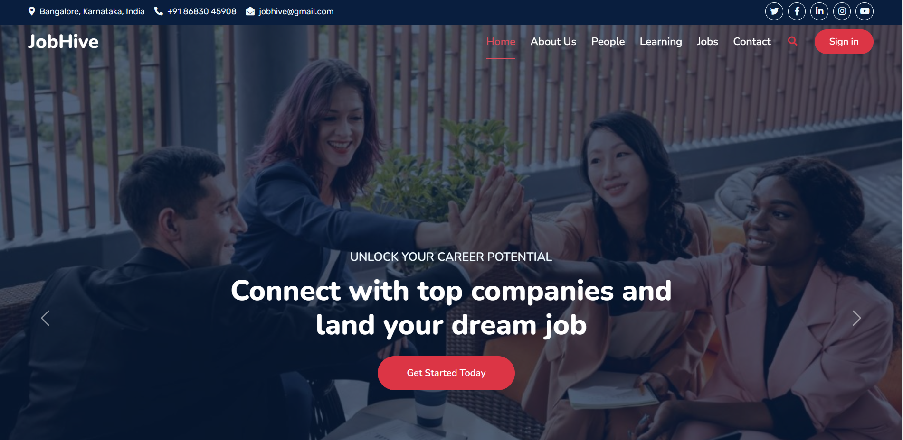
GitHub Link :- https://github.com/keerti1924/JobHive-Project-Job-Platform

Slide 14
Thank You

